Slide 1




Enhancing Interview Preparedness: A Comprehensive Web Application.
SRI LANKA INSTITUTE OF INFORMATION TECHNOLOGY
24-25J-082

Slide 2
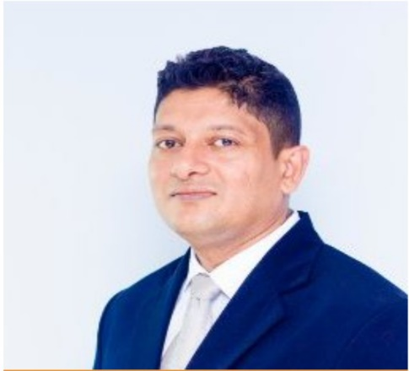





Our Team
MR. S.M.B. HARSHANATH
DR. HARINDA FERNANDO
PATHIRANA V.P.E.P.V.
(Leader)
SENAVIRATHNA D.M.O.C.
KAVINDYA N.D.D.
SATHKUMARA S.M.P.U.
24-25J-082

Slide 3

Agenda
Introduction 4
Research Problems 5
Main Objective 6
System Overview Diagram 7
Individual Components 8
Budget 72

Slide 4
Introduction
In today’s competitive job market, being well-prepared for interviews is crucial. Our project aims to create a web application that uses machine learning to help users get ready for interviews.
The app will provide personalized quiz assessments to identify strengths and areas for improvement, suggest videos for learning specific skills, offer virtual interview practice with realistic avatars, and help users create professional resumes.
These features will boost confidence, enhance skills, and provide the necessary tools for users to succeed in their job search.
24-25J-082

Slide 5
Research Problem
Lack of Personalized MCQ Systems
Overwhelming Interview Preparation Content
Limited Realistic Interview Practice
Time-Consuming and Inconsistent CV Creation

Slide 6
Main Objective
The main objective of this research is to develop a comprehensive web application that enhances interview preparedness through the integration of machine learning techniques. The platform aims to improve user experience and learning outcomes by offering tailored MCQ assessments, personalized video recommendations, simulated interview panels, and customized CV generation.

Slide 7












System Diagram
MCQ Levelup Controlling
Intelligence Video & Tutorial Recommendation
User
Web Application
Database
2D Interview Panel Simulation
AI Powered Career Path Guidance

Slide 8

IT21286650 | Senevirathna d m o c
Specialization – Information Technology
Component 1 – MCQ Levelup System
IT21286650 | Senevirathna D M O C | 24-25J-082

Slide 9

Introduction and Background
The MCQ Levelup Controlling component aims to enhance interview preparation by providing a dynamic, adaptive system of multiple-choice questions (MCQs).
Traditional interview preparation methods lack personalization and adaptability, often failing to meet individual learning needs and job-specific requirements.
There is a need for innovative solutions that offer tailored preparation experiences and real-time feedback.
The MCQ Levelup Controlling component addresses this gap by providing an adaptive learning system that evolves with user performance, enhancing readiness and confidence for job interviews through personalized, relevant content.
IT21286650 | Senevirathna D M O C | 24-25J-082

Slide 10
Research Gap
Traditional interview preparation methods lack personalization and adaptability, often failing to address individual learning needs and proficiency levels.
The MCQ Levelup Controlling component aims to fill this gap by providing a dynamic, role-specific, and adaptive question system that offers real-time feedback and progressive difficulty adjustment.
IT21286650 | Senevirathna D M O C | 24-25J-082

Slide 11


Research Gap
RESEARCH [1]
RESEARCH [2]
RESEARCH [3]
RESEARCH [4]
PROPOSED
SOLUTION
Integrate Real-Time
Feedback
Utilize Reinforcement Learning
Customize Job Role Preparation
Improve User Engagement and Learning Outcomes
IT21286650 | Senevirathna D M O C | 24-25J-082

Slide 12

Research Problem
How can an adaptive MCQ system be designed to personalize interview preparation by dynamically tailoring questions to individual job roles and proficiency levels, providing real-time feedback, and adjusting the difficulty based on user performance?
IT21286650 | Senevirathna D M O C | 24-25J-082

Slide 13

Specific Objectives
To develop and implement the MCQ Levelup Controlling component within a comprehensive web application that enhances interview preparedness through machine learning techniques.
IT21286650 | Senevirathna D M O C | 24-25J-082

Slide 14

Sub Objectives
Job Role Customization
Dynamic Difficulty Adjustment
Real-Time Feedback
Reinforcement Learning Integration
Question Bank Management
User Interface Design
Performance Monitoring
IT21286650 | Senevirathna D M O C | 24-25J-082

Slide 15
Novelty
“The novelty of our MCQ Levelup Controlling component lies in its dynamic adaptation to users' job roles and proficiency levels, coupled with real-time feedback and reinforcement learning to personalize and optimize interview preparation.”
IT21286650 | Senevirathna D M O C | 24-25J-082

Slide 16
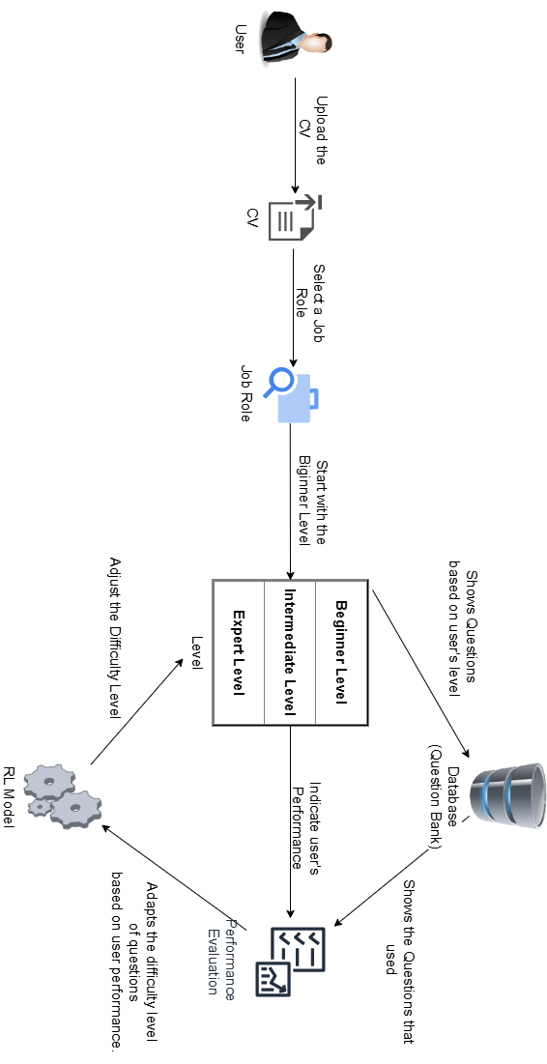
System Diagram
IT21286650 | Senevirathna D M O C | 24-25J-082

Slide 17






Technologies
React js
Flask
GitLab
VS Code
MySQL
Spring boot
IT21286650 | Senevirathna D M O C | 24-25J-082

Slide 18

Functional Requirements
User Role Selection
Adaptive Difficulty
Three-Level Difficulty System
Real-Time Feedback
Progress Tracking
Question Bank Management
Reinforcement Learning
Security & Privacy
IT21286650 | Senevirathna D M O C | 24-25J-082

Slide 19
Non-Functional Requirements
Performance
Scalability
Reliability
Usability
IT21286650 | Senevirathna D M O C | 24-25J-082

Slide 20
Work Breakdown Structure
Group registration
Project proposal
PP1
PP2
Final Stage
Supervisor Selection
Supervisor guidance and discussion
Supervisor consultation
Final stage guidance
Completion of final product
Phase 1 implementation
Phase 2 implementation
Testing and evaluation
Online Group Registration
Additional data and research paper gathering
Progress Presentation - I
Progress Presentation 2
Final report
Background analysis, group discussion, data and research paper collection, knowledge gap, research problem and novelty identification, Title selection
Preparation and finalization of Research paper
Final presentation & VIVA
Status document I submission
Requirement analysis and technology assessment.
Hardware design and specifications
Status document 2 submission
Research paper submission
Proposal presentation
Complete research logbook
TAF Submission
Prepare proposal report and submission
Project charter submission
IT21286650 | Senevirathna D M O C | 24-25J-082

Slide 21
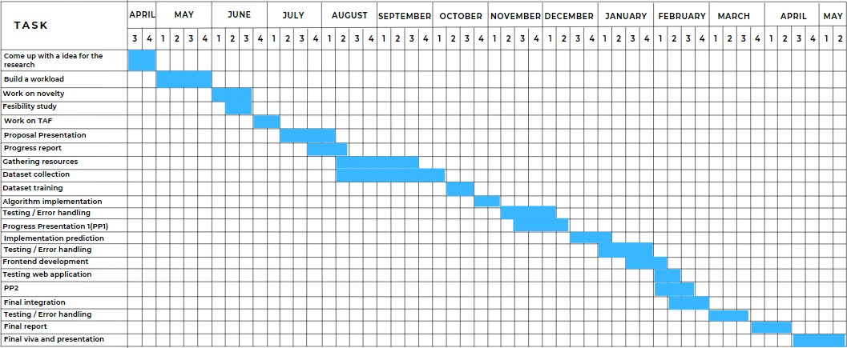
Gantt Chart
IT21286650 | Senevirathna D M O C | 24-25J-082

Slide 22
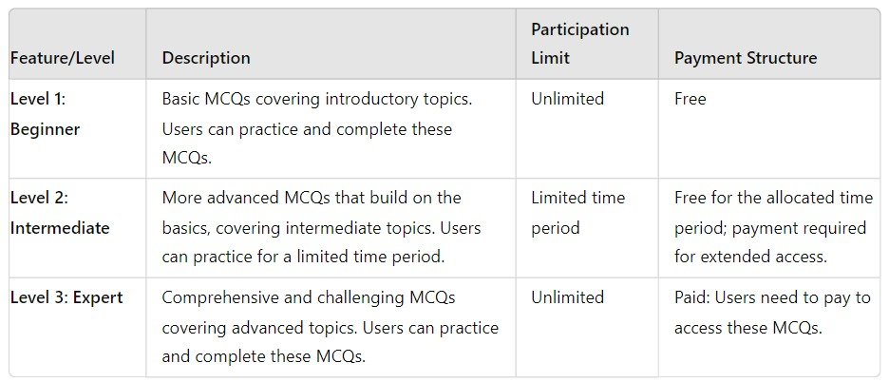
Commercialization
IT21286650 | Senevirathna D M O C | 24-25J-082

Slide 23
References
[1] S. K. ,. T. T. ,. W. W. G. M. V. S. ,. W. M. K. ,. E. E. M. O. M. ,. K. S. R. M. J. S. Rajapaksha, "Guru Gedara: Smart Mathematical e-learning Platform for Grade Five Students,” INTERNATIONAL CONFERENCE ON ADVANCED RESEARCH IN COMPUTING;, 21 February 2021.
[2] T. Alsubait, B. Parsia and U. Sattler, "A similarity-based theory of controlling MCQ difficulty," 2013 Second International Conference on E-Learning and E-Technologies in Education (ICEEE), Lodz, Poland, 2013, pp. 283-288, doi: 10.1109/ICeLeTE.2013.6644389.
[3] D. R. CH and S. K. Saha, "Automatic Multiple Choice Question Generation From Text: A Survey," in IEEE Transactions on Learning Technologies, vol. 13, no. 1, pp. 14-25, 1 Jan.-March 2020, doi: 10.1109/TLT.2018.2889100.
[4] C. N. Hang, C. Wei Tan and P. -D. Yu, "MCQGen: A Large Language Model-Driven MCQ Generator for Personalized Learning," in IEEE Access, vol. 12, pp. 102261-102273, 2024, doi: 10.1109/ACCESS.2024.3420709.
IT21286650 | Senevirathna D M O C | 24-25J-082

Slide 24
IT21231278 | Kavindya N D D
Specialization – Information Technology
Component 2 – Intelligent Video and Tutorial Recommendation
IT21231278 | Kavindya N D D | 24-25J-082

Slide 25
Background
The rise of online interview platforms has transformed the recruitment process, making it more efficient and accessible.
Key components of these platforms are video interviews and tutorials. Video interviews allow employers to assess candidates' communication skills and personalities beyond what a resume can show, while tutorials help candidates prepare effectively for the interview process.
Despite their importance, there is limited research on the best practices for integrating these elements to maximize their effectiveness.
This study aims to explore and enhance the design and implementation of video and tutorial features in online interview systems to improve both candidate experience and hiring outcomes.
IT21231278 | Kavindya N D D | 24-25J-082

Slide 26
Research Gap
Impact of Video Interviews on Candidate Evaluation
Effectiveness of Tutorials in Candidate Preparation
User Experience and Accessibility
Integration of AI and Machine Learning
Cultural and Demographic Considerations
IT21231278 | Kavindya N D D | 24-25J-082

Slide 27
Research Gap
RESEARCH [1]
RESEARCH [2]
RESEARCH [3]
RESEARCH [4]
PROPOSED
SOLUTION
Impact of Video Interviews on Candidate Evaluation
Effectiveness of Tutorials in Candidate Preparation
User Experience and Accessibility
Integration of AI and Machine Learning
IT21231278 | Kavindya N D D | 24-25J-082

Slide 28
Research Problem
How do video interview formats and tutorial types affect the accuracy and effectiveness of online interviews?
How can we make online interview platforms better for users, and how can AI be used to provide helpful feedback and tutorials while addressing privacy concerns?
IT21231278 | Kavindya N D D | 24-25J-082

Slide 29
Specific Objectives
To enhance the effectiveness of video and tutorial components in online interview platforms by addressing the research gaps and improving candidate evaluation, preparation, user experience, and inclusivity.
IT21231278 | Kavindya N D D | 24-25J-082

Slide 30
Sub Objectives
Evaluate the Impact of Different Video Interview Formats on Candidate Evaluation
Analyze User Experience and Accessibility of Video and Tutorial Components
Investigate the Integration of AI and Machine Learning in Video Interviews and Tutorials
Examine the Impact of Cultural and Demographic Factors on Video Interviews and Tutorials
IT21231278 | Kavindya N D D | 24-25J-082

Slide 31
Novelty
“Our video and tutorial component stands out with its advanced features, including AI-driven personalized recommendations, interactive video elements, and real-time collaboration tools. It ensures high-quality streaming and secure content access, while providing seamless integration with interview tools and cross-platform support. This combination of innovations delivers a superior and engaging user experience.”
IT21231278 | Kavindya N D D | 24-25J-082

Slide 32
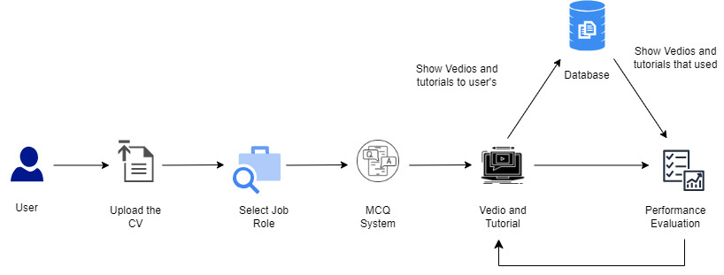
System Diagram
IT21231278 | Kavindya N D D | 24-25J-082

Slide 33
Technologies
React js
Flask
GitLab
VS Code
MySQL
Spring boot
IT21231278 | Kavindya N D D | 24-25J-082

Slide 34
Functional Requirements
Video Interview Functionality
Tutorial Functionality
User Management
Integration and Compatibility
Real-Time Feedback
Security
IT21231278 | Kavindya N D D | 24-25J-082

Slide 35
Non-Functional Requirements
Performance
Usability
Reliability
Maintainability
IT21231278 | Kavindya N D D | 24-25J-082

Slide 36
Work Breakdown Structure
Group registration
Project proposal
PP1
PP2
Final Stage
Supervisor Selection
Supervisor guidance and discussion
Supervisor consultation
Final stage guidance
Completion of final product
Phase 1 implementation
Phase 2 implementation
Testing and evaluation
Online Group Registration
Additional data and research paper gathering
Progress Presentation - I
Progress Presentation 2
Final report
Background analysis, group discussion, data and research paper collection, knowledge gap, research problem and novelty identification, Title selection
Preparation and finalization of Research paper
Final presentation & VIVA
Status document I submission
Requirement analysis and technology assessment.
Hardware design and specifications
Status document 2 submission
Research paper submission
Proposal presentation
Complete research logbook
TAF Submission
Prepare proposal report and submission
Project charter submission
IT21231278 | Kavindya N D D | 24-25J-082

Slide 37
Gantt Chart
IT21231278 | Kavindya N D D | 24-25J-082

Slide 38
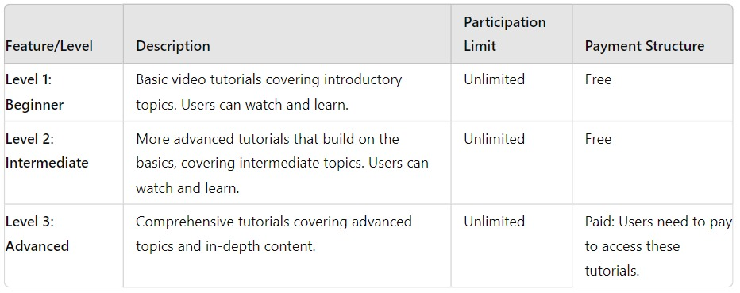
Commercialization
IT21231278 | Kavindya N D D | 24-25J-082

Slide 39
References
[1]N. Roulin, "Is More Always Better? How Preparation Time and Re-recording Opportunities Impact Fairness, Anxiety, Impression Management, and Performance in Asynchronous Video Interviews," Journal of Business and Psychology, vol. 36, no. 4, pp. 599-617, 2021.
[2]L. Barrick and C. Mount, "Interactive Tutorials for Online Job Interview Preparation: An Empirical Evaluation," IEEE Transactions on Learning Technologies, vol. 13, no. 3, pp. 329-340, 2020.
[3]"Ensuring Accessible Digital Interviews," Peatworks, 2020. This article outlines accessibility-related challenges and provides solutions for making digital interviews fairer and more inclusive.
[4]M. Sharma and K. Thakur, "Leveraging AI for Real-Time Feedback in Video Interviews," IEEE Access, vol. 9, pp. 123456-123467, 2021.
IT21231278 | Kavindya N D D | 24-25J-082

Slide 40

IT21175084 | Pathirana V P E P V
Specialization – Information Technology
Component 3 – 2D Interview Panel Simulation
IT21175084 | Pathirana V P E P V | 24-25J-082

Slide 41

Introduction and Background
The "2D Interview Panel Simulation" project is designed to help users practice and improve their interview skills. (It uses 2D avatars to simulate interviews at three levels.)
The avatars ask questions generated by machine learning models, either decision trees or artificial neural networks (ANNs).
The system provides realistic interview practice by increasing the difficulty of questions, helping users build confidence and get better prepared for real interviews.
This approach makes practicing for interviews more engaging and effective compared to traditional methods.
IT21175084 | Pathirana V P E P V | 24-25J-082

Slide 42
Research Gap
Advanced Design Techniques for Realistic 2D Avatars
Application of Decision Tree and ANN Models in Interview Simulations
Efficient Integration of ML Models with 2D Simulation Systems
User Engagement Strategies in 2D Practice Environments
Ensuring Accuracy, Reliability, and Effectiveness in 2D Interview Simulations
IT21175084 | Pathirana V P E P V | 24-25J-082

Slide 43
Research Gap
Advanced Design Techniques for Realistic 2D Avatars
RESEARCH [1]
RESEARCH [2]
RESEARCH [3]
RESEARCH [4]
PROPOSED
SOLUTION
Application of Decision Tree and ANN Models in Interview Simulations
Efficient Integration of ML Models with 2D Simulation Systems
User Engagement Strategies in 2D Practice Environments
IT21175084 | Pathirana V P E P V | 24-25J-082

Slide 44
Research Problem
How to design 2D avatars that can realistically simulate human interviewers in terms of behavior, questioning style, and feedback?
How to ensure that the decision tree and ANN models can accurately generate and adapt interview questions based on the user's performance and the chosen difficulty level (Beginner, Intermediate, Expert)?
IT21175084 | Pathirana V P E P V | 24-25J-082

Slide 45

Specific Objectives
Develop an Interactive 2D Interview Panel Simulation
Provide User-Friendly Interface and Experience
IT21175084 | Pathirana V P E P V | 24-25J-082

Slide 46
Sub Objectives
Create lifelike 2D avatars.
Develop Beginner, Intermediate, and Expert interview levels.
Train models to generate questions for each level.
Integrate machine learning models into the system.
Test and validate the simulation for realism and effectiveness.
IT21175084 | Pathirana V P E P V | 24-25J-082

Slide 47
Novelty
“The ‘2D Interview Panel Simulation’ project uses AI-generated questions from decision trees or ANNs, delivered by 2D avatars, to provide progressively challenging and realistic interview practice for enhanced user preparedness.”
IT21175084 | Pathirana V P E P V | 24-25J-082

Slide 48
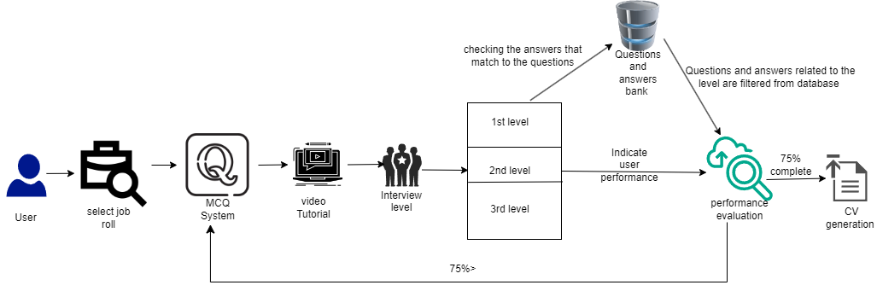
System Diagram
IT21175084 | Pathirana V P E P V | 24-25J-082

Slide 49
Technologies
React js
Flask
GitLab
VS Code
MySQL
Spring boot
IT21175084 | Pathirana V P E P V | 24-25J-082

Slide 50
Functional Requirements
User Authentication and Profile Management
Interview Simulation Levels
Question Generation and Feedback
Progress Tracking and Analytics
Interactive 2D Avatars
Security and Privacy
IT21175084 | Pathirana V P E P V | 24-25J-082

Slide 51
Non-Functional Requirements
Performance and Scalability
Usability and User Experience
Reliability and Availability
Maintainability and Extensibility
IT21175084 | Pathirana V P E P V | 24-25J-082

Slide 52
Work Breakdown Structure
Group registration
Project proposal
PP1
PP2
Final Stage
Supervisor Selection
Supervisor guidance and discussion
Supervisor consultation
Final stage guidance
Completion of final product
Phase 1 implementation
Phase 2 implementation
Testing and evaluation
Online Group Registration
Additional data and research paper gathering
Progress Presentation - I
Progress Presentation 2
Final report
Background analysis, group discussion, data and research paper collection, knowledge gap, research problem and novelty identification, Title selection
Preparation and finalization of Research paper
Final presentation & VIVA
Status document I submission
Requirement analysis and technology assessment.
Hardware design and specifications
Status document 2 submission
Research paper submission
Proposal presentation
Complete research logbook
TAF Submission
Prepare proposal report and submission
Project charter submission
IT21175084 | Pathirana V P E P V | 24-25J-082

Slide 53
Gantt Chart
IT21175084 | Pathirana V P E P V | 24-25J-082

Slide 54
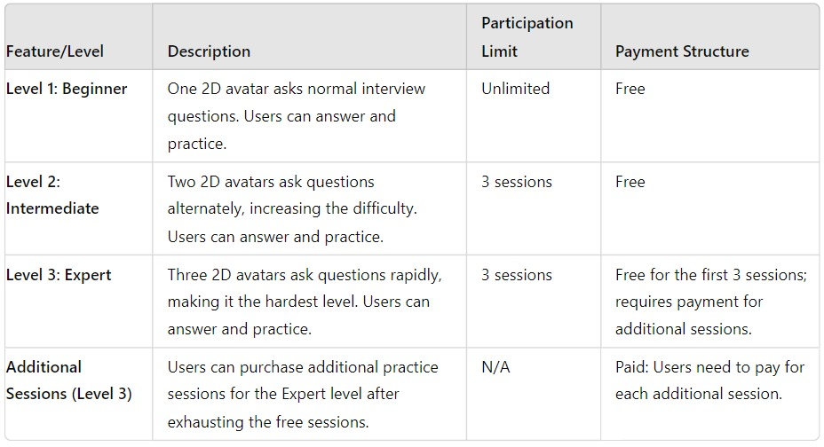
Commercialization
IT21175084 | Pathirana V P E P V | 24-25J-082

Slide 55
References
[1] S. K. ,. T. T. ,. W. W. G. M. V. S. ,. W. M. K. ,. E. E. M. O. M. ,. K. S. R. M. J. S. Rajapaksha, "Guru Gedara: Smart Mathematical e-learning Platform for Grade Five Students,” INTERNATIONAL CONFERENCE ON ADVANCED RESEARCH IN COMPUTING;, 21 February 2021.
[2] T. Alsubait, B. Parsia and U. Sattler, "A similarity-based theory of controlling MCQ difficulty," 2013 Second International Conference on E-Learning and E-Technologies in Education (ICEEE), Lodz, Poland, 2013, pp. 283-288, doi: 10.1109/ICeLeTE.2013.6644389.
[3] D. R. CH and S. K. Saha, "Automatic Multiple Choice Question Generation From Text: A Survey," in IEEE Transactions on Learning Technologies, vol. 13, no. 1, pp. 14-25, 1 Jan.-March 2020, doi: 10.1109/TLT.2018.2889100.
[4] C. N. Hang, C. Wei Tan and P. -D. Yu, "MCQGen: A Large Language Model-Driven MCQ Generator for Personalized Learning," in IEEE Access, vol. 12, pp. 102261-102273, 2024, doi: 10.1109/ACCESS.2024.3420709.
IT21175084 | Pathirana V P E P V | 24-25J-082

Slide 56
IT21306136 | Sathkumara S M P U
Specialization – Information Technology
Component 4 – AI Powered Career Path Guidance
IT21306136 | Sathkumara S M P U | 24-25J-082

Slide 57
Introduction and Background
The AI-Powered Career Path Guidance component was developed in response to the evolving demands of the modern job market, where individuals face significant challenges in career planning due to rapid changes in industry requirements and the emergence of new job roles.
Traditional career counseling methods often lack the personalization and real-time insights necessary to effectively guide job seekers.
Leveraging advancements in AI and machine learning, this component provides personalized career recommendations, skill gap analysis, and job market insights by analyzing user data such as educational background, work experience, skills, and performance in mock interviews.
This data-driven approach empowers users to make informed career decisions, stay updated with industry trends, and enhance their job readiness through customized learning plans.
IT21306136 | Sathkumara S M P U | 24-25J-082

Slide 58
Research Gap
Personalization and Contextual Understanding
Integration of Real-Time Market Data
Skill Gap Analysis and Adaptive Learning
User Engagement and Feedback Mechanisms
Ethical Considerations and Bias Mitigation
IT21306136 | Sathkumara S M P U | 24-25J-082

Slide 59
Research Gap
RESEARCH [1]
RESEARCH [2]
RESEARCH [3]
RESEARCH [4]
PROPOSED
SOLUTION
Personalization and Contextual Understanding
Integration of Real-Time Market Data
Skill Gap Analysis and Adaptive Learning
User Engagement and Feedback Mechanisms
IT21306136 | Sathkumara S M P U | 24-25J-082

Slide 60
Research Problem
How can an AI-powered career guidance system, utilizing machine learning algorithms, provide personalized and accurate career path recommendations to improve users' career decision-making and job readiness?
What is the impact of integrating real-time job market data and dynamic skill gap analysis on the effectiveness and relevance of personalized career guidance provided by AI-powered systems?
IT21306136 | Sathkumara S M P U | 24-25J-082

Slide 61
Specific Objectives
The main objective of the AI-Powered Career Path Guidance component is to enhance job seekers' decision-making and job readiness by providing personalized career path recommendations, identifying skill gaps, and creating targeted learning plans using advanced machine learning algorithms. This ensures users receive tailored guidance, relevant job market insights, and effective skill development resources to achieve their career goals
IT21306136 | Sathkumara S M P U | 24-25J-082

Slide 62
Sub Objectives
Enhance Personalization
Integrate Real-Time Market Data
Improve Skill Gap Analysis
Incorporate User Feedback
Address Bias and Ethical Concerns
IT21306136 | Sathkumara S M P U | 24-25J-082

Slide 63
Novelty
“The novelty of our AI-powered career path guidance component lies in its ability to provide highly personalized, data-driven learning plans and certification recommendations based on real-time skill gap analysis, ensuring targeted career advancement for IT professionals.”
IT21306136 | Sathkumara S M P U | 24-25J-082

Slide 64
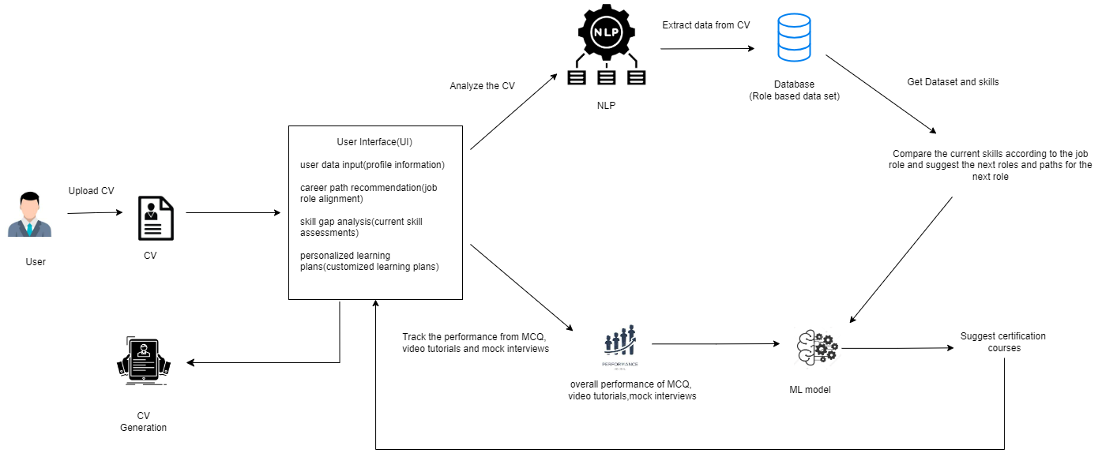
System Diagram
IT21306136 | Sathkumara S M P U | 24-25J-082

Slide 65
Technologies
React js
Flask
GitLab
VS Code
MySQL
Spring boot
IT21306136 | Sathkumara S M P U | 24-25J-082

Slide 66
Functional Requirements
User Data Collection and Profile Creation
Career Path Recommendations
Personalized Learning Plans
Progress Tracking and Feedback
Skill Gap Analysis
Security and Privacy
IT21306136 | Sathkumara S M P U | 24-25J-082

Slide 67
Non-Functional Requirements
Performance
Scalability
Reliability
Usability
IT21306136 | Sathkumara S M P U | 24-25J-082

Slide 68
Work Breakdown Structure
Group registration
Project proposal
PP1
PP2
Final Stage
Supervisor Selection
Supervisor guidance and discussion
Supervisor consultation
Final stage guidance
Completion of final product
Phase 1 implementation
Phase 2 implementation
Testing and evaluation
Online Group Registration
Additional data and research paper gathering
Progress Presentation - I
Progress Presentation 2
Final report
Background analysis, group discussion, data and research paper collection, knowledge gap, research problem and novelty identification, Title selection
Preparation and finalization of Research paper
Final presentation & VIVA
Status document I submission
Requirement analysis and technology assessment.
Hardware design and specifications
Status document 2 submission
Research paper submission
Proposal presentation
Complete research logbook
TAF Submission
Prepare proposal report and submission
Project charter submission
IT21306136 | Sathkumara S M P U | 24-25J-082

Slide 69
Gantt Chart
IT21306136 | Sathkumara S M P U | 24-25J-082

Slide 70
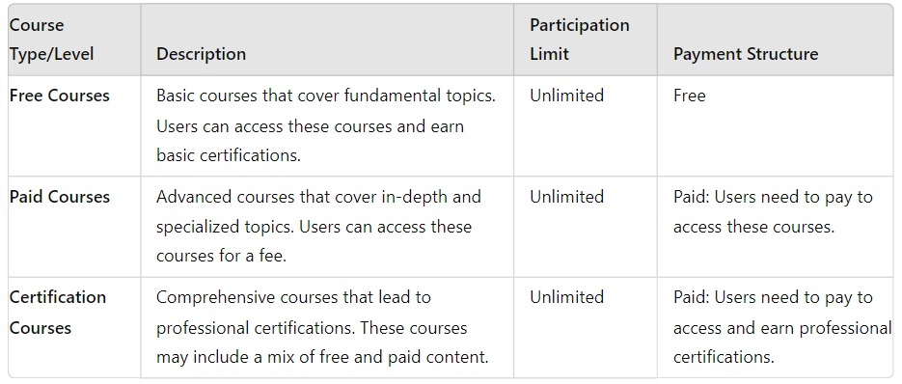
Commercialization
IT21306136 | Sathkumara S M P U | 24-25J-082

Slide 71
References
[1]C. Atwell, L. S. Marcolino, "Personalized Career Path Recommendations Using AI," IEEE Transactions on Knowledge and Data Engineering, vol. 32, no. 4, pp. 792-804, Apr. 2020.
[2]S. Ghosh, R. Islam, M. Uddin, "Integrating Real-Time Job Market Data into Career Guidance Systems," IEEE Access, vol. 8, pp. 21548-21557, 2020.
[3]H. Li, Z. Zhang, L. Zhang, "AI-Driven Skill Gap Analysis for Personalized Learning," IEEE Transactions on Learning Technologies, vol. 13, no. 2, pp. 271-280, 2020.
[4]J. Lee, K. H. Lee, "User Feedback Integration in AI-Based Career Recommendation Systems," IEEE Transactions on Human-Machine Systems, vol. 50, no. 5, pp. 368-378, Oct. 2020.
IT21306136 | Sathkumara S M P U | 24-25J-082

Slide 72
Budget
Estimated Budget Per Month | Amount(LKR)
Power Bill Charges | 1500.00
Internet Charges (The development and technical information learning) | 3500.00
Extra Charges | 1000.00
Total | 6000.00

Slide 73
THANK YOU

